Slide 1
Frontend frameworks
CA1 – VUE COUNTRIES

Slide 2
The Role of the Elements I’ve Used:
My Vue Components:
Vue Router:
My APIs:
RestCountries:
Unsplash & Pexels:
OpenWeatherMap:
Newsapi & Translated—mymemory:
TheMealDB:
OpenTripMap:
Geolocation (Time):

Slide 3
Structure of Components/Pages:
Card – Used for: Events, Food, News, Attractions
Carousel:
CountryViewer:
NavBar:

Slide 4
About the libraries I’ve used:
Axios:
Vue-Paginate:

Slide 5
Testing & Debugging:
Issues I’ve encountered:
The issue I fixed using :key on router-view, instead of forcing UI update
Using a second call to pexels in the catch of unsplash

Slide 6
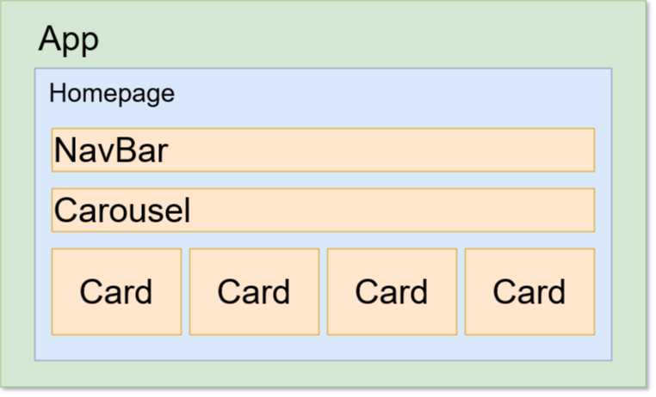
Homepage Component Structure

Slide 7
All Countries Component Structure

